Slide 1
Announcements
Project 6 is out:
Due next Monday. Opportunity to build something from scratch. Will probably take some experimentation on your part.
I’ve delegated autograder development to Allen. Thanks Allen!
See great Piazza thread here: https://piazza.com/class/is2qi3hwdjn3i8?cid=1505
Remember Midterm 2? It is 97% graded. Meeting tonight to finish.
Final exam will be comrehensive.
Information on review sessions coming soon.

Slide 2
CS188: Fall 2016
Lecture 26: Conclusion
188 in a Huge Nutshell.
The Future of AI.
AMA.
After 188.
Survey.

Slide 3
188
Throughout 188, we learned to maximize our expected utility.
Three main parts to course:
Part I: Search (culminating in A* for state space search, Min-Conflicts and CSP-Backtracking for CSPs, Policy/Value Iteration for MDPs, Q-Learning for RL)
Part II: Probabilistic Inference (culminating in Variable Elimination and Gibbs Sampling for Inference, and ideas of VPI/Decision Networks for solving real problems).
Part III: Machine Learning (culminating in Neural Networks for classification and Backpropagation+Gradient Descent for training).

Slide 4
Part I: Search -- State Space Search
DFS
Uninformed Search
path to goal
Search Problem:
State Space
Successor Function
Start State
Goal Test
BFS
UCS
optimal path to goal
Informed Search
A* Tree Search
A* Graph Search
Good to know when each is complete/optimal.
Lecture 1/2/3

Slide 5
Part I: Search -- Constraint Satisfaction Problems
DFS/BFS
Correct Assignment
CSP-Backtracking
CSP:
Variables
Domains
Constraints
FC
AC
MRV
LCV
TREE
CUTSET
Min-Conflicts
Hopefully Correct Assignment
Simulated Annealing
Genetic Algorithms
Only briefly discussed SA, GA
Lecture 4/5

Slide 6
Part I: Search -- Deterministic (Adversarial) Games
Deterministic Game:
States: S (+start)
Players: P = {1 …N}
Actions: A
Transition Function: SxA → S
Terminal Test: S → {t, f}
Terminal Utilities: SxP → R
Minimax
(replanning algorithm)
Depth Limited Minimax
Optimal Policy:
S → A
Alpha-beta
Expectimax
(More formal input: MDP)
State
Evaluation Function
Utility Estimate
Note #1: Replanning algorithms give a policy only for current state! Can thrash.
Note #2: If N > 2, players optimize values from a tuple.
Lecture 6/7

Slide 7
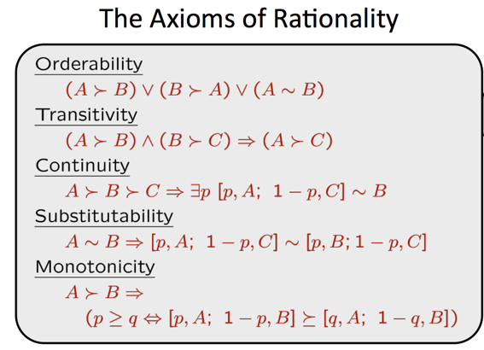
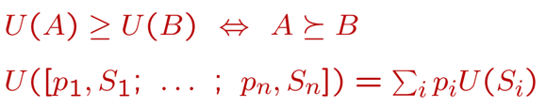
Part I: Search -- Formal Definition of Utility
Given any preferences satisfying these axioms, there is a real-valued function U such that:
Lottery
Lecture 7

Slide 8
Part I: Search -- Markov Decision Processes
Markov Decision Process
States: S (+start)
Actions: A
Transition Function: T(s, a, s’)
Reward Function: R(s, a, s’)
Terminal Test (opt): S → {t, f}
(and Discount Factor)
Expectimax
Value Iteration
Optimal Policy:
S → A
Optimal State Values
Bellman Equation
Optimal? Yes/No
State Values
Note: Value Iteration is repeated application of Bellman Equation to find optimal state values.
Lecture 8

Slide 9
Part I: Search -- Markov Decision Processes
Markov Decision Process
States: S (+start)
Actions: A
Transition Function: T(s, a, s’)
Reward Function: R(s, a, s’)
Terminal Test (opt): S → {t, f}
(and Discount Factor)
Expectimax
Value Iteration
Optimal Policy:
S → A
Optimal State Values
Policy Iteration
Policy: S → A
Policy Evaluation
Values of States under Policy
State Values
Policy Extraction
Policy: S → A
Note: Each iteration of policy iteration is one call to policy evaluation, followed by one policy extraction.
Lecture 9

Slide 10
Part I: Search -- Reinforcement Learning
Markov Decision Process
States: S (+start)
Actions: A
Transition Function: T(s, a, s’) (unknown)
Reward Function: R(s, a, s’) (unknown)
Terminal Test (opt): S → {t, f}
(and Discount Factor)
Model Based RL
Outcome Counting
T(s, a, s’)
R(s, a, s’)
Direct Evaluation
Optimal State Values
Temporal Difference Learning
Passive RL
Optimal Q-Values
Examples to Watch, a.k.a. Policy S → A
Q-Learning
Active RL
Optimal Policy S→ A
Note: TDL is actually good at what it does, but optimal state values are of questionable use.
Lecture 10

Slide 11
Part I: Search -- Reinforcement Learning
Markov Decision Process
States: S (+start)
Actions: A
Transition Function: T(s, a, s’) (unknown)
Reward Function: R(s, a, s’) (unknown)
Terminal Test (opt): S → {t, f}
(and Discount Factor)
Optimal Q-Values
Q-Learning
Active RL
Optimal Policy S→ A
Use epsilon-greedy or exploration function to decide when to explore and when to exploit.
Feature Optimal Q-Values
Featurizer
Q-Learning
Active RL
Feature Optimal Policy S→ A
Note #1: Important to adjust learning rate over time for Q-Learning.
Note #2: TDL is actually good at what it does, but optimal state values are of questionable use.
Policy search?
Lecture 11

Slide 12
Part II: Inference -- Bayes Nets
Bayes Net
A set of nodes, one per variable X
DAG
CPT per node
Inference by Enumeration
P(Q₁, …, Q_{m} | e₁, …, e_{k})
Variable Elimination
Represents P(X₀,...X_{N})
Prior Sampling
Rejection Sampling
List of Query variables, evidence.
Likelihood Weighting
Gibbs Sampling
Note #1a: Inference in Bayes Nets is NP-Hard for general case.
Note #1b: Polytrees (no undirected cycles) always allow efficient variable orderings.
Note #2: Can use samples directly to approximate a distribution even without a Bayes Net.
Note #3: Did not fully discuss in class how to do efficient resampling in one variable for Gibbs.
Lecture 12/13/14/15

Slide 13
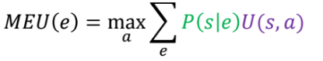
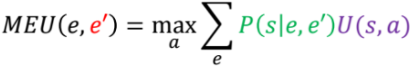
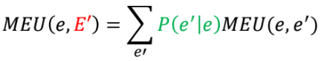
Part II: Inference -- Bayes Nets
Decision Networks
Bayes Net
Action Nodes
Utility Node
Table Lookup
EU(A | e₁, …, e_{k})
Let Z₁, …, Z_{k} be parents of Utility Node.
P(Z₁, …, Z_{m} | e₁, …, e_{k})
Computed using techniques from last slide.
Choice of Action A
Note: Gives rise to POMDPs.
Lecture 16

Slide 14
Part II: Inference -- HMMs
Markov Model is a BN, but:
Sequence of nodes X_{i} in increasing order.
CPTs all the same.
Can be extended infinitely.
Mini-Forward
Later P(X_{t+k})
Known P(X_{t})
e_{t}
HMM is a MM, but:
Don’t observe X_{i} directly.
Evidence variables for each X_{i} → E_{i}
Forward Algorithm
P(x_{t} | e_{1:t})
P(x_{t-1}, e_{1:t-1})
Note #1: A MM has a stationary distribution P(X∞)
Lecture 17

Slide 15
Part II: Inference -- Particle Filtering [coming later]
Lecture 18

Slide 16
Part III: Machine Learning -- Naive Bayes
Naive Bayes Net, BN but:
One class variable C.
N feature variables F_{i}.
C points at every feature variable.
Any BN Inference Technique
P(C | f₁, …, f_{N})
Feature vector f₁, …, f_{N}
Classification
Naive BN with unknown CPT parameters.
Maximum Likelihood Estimator
CPT parameters θ
Set of labeled examples
Maximum A Posteriori Estimator (Laplacian Smoothing)
Training
Lecture 19

Slide 17
Part III: Machine Learning -- Perceptron
binary
Weight vector
Dot Product + Threshold
+c or -c
Weight vectors
Dot Product + ArgMax
c
Feature vector f₁, …, f_{N}
multiclass
Note: Binary classifier draws separating hyperplane.
Perceptron Classification
Weight vectors
DP + ArgMax
Perceptron Update Rule
Weight vectors
feature vector
correct label
MIRA Update Rule
Note #1: Perceptron UR overshoots!
Note #2: Similar classifier called SVM is very important. Covered in 189. Similar to MIRA, but optimizes over all data at once instead of single data point.
Training
Lecture 20

Slide 18
Part III: Machine Learning -- Deep Learning / Multilayer Perceptron
Weight vector
binary
DP + Activation Function
Real number
Threshold
+c or -c
Feature vector f₁, …, f_{N}
Binary Neuron Calculation
weight vector
Finite Difference Approximation
feature vector(s)
Gradient of LF
Analytic Calculation
correct label(s)
Back Propagation
loss function
new weight vector
Gradient of LF
Update (with or w.o. momentum)
Neuron Training: Gradient Descent
Note: 1 sample is Stochastic Gradient Descent, k samples is mini-batching
Lecture 21/22

Slide 19
Part III: Machine Learning -- Deep Learning / Multilayer Perceptron
Weight vectors
binary
DP + Activation Functions
Real number
Threshold
+c or -c
Feature vector f₁, …, f_{N}
Neural Network Calculation
weight vectors
Finite Difference Approximation
feature vector(s)
Gradient of LF
Analytic Calculation
correct label(s)
Back Propagation
loss function
new weight vectors
Gradient of LF
Update (with or w.o. momentum)
Network Training: Gradient Descent
Note: 1 sample is Stochastic Gradient Descent, k samples is mini-batching
Lecture 21/22

Slide 20
The Future of AI

Slide 21
News
Google's DeepMind AI Can Lip-Read TV Shows Better Than a Pro
New Scientist (11/21/16) Hal Hodson
Researchers at Google's DeepMind and the University of Oxford are applying deep-learning techniques to a massive dataset of BBC TV programs to create a lip-reading system that can perform better than professional lip readers. The artificial intelligence (AI) system was trained using 5,000 hours from six TV programs that aired between January 2010 and December 2015.
The AI's lip-reading performance was then tested on TV programs broadcast between March and September 2016, accurately deciphering 46.8 percent of all words without any errors. In comparison, a professional lip reader deciphered just 12.4 percent of words correctly in a dataset of 200 clips. Many of the AI's errors were small, such as missing an "s" at the end of the word.
Notes:
John

Slide 22

News
Notes:
John

Slide 23
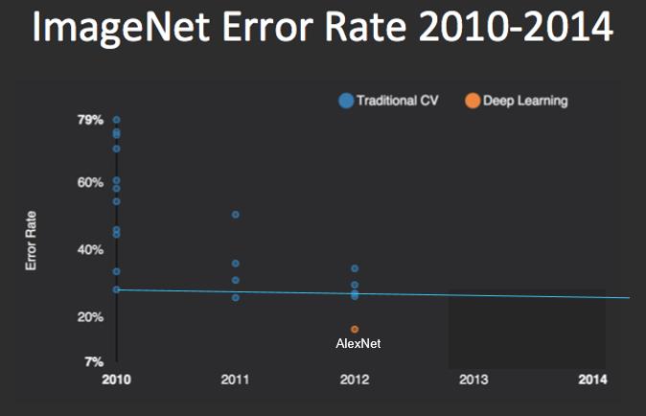
Old News (2012)
Notes:
John

Slide 24
History of Deep Learning
Some key ideas:
1958: Perceptrons (Rosenblatt)
1986: Multilayer Perceptrons and Backpropagation (Rumelhart)
1989: Convolutional Networks (LeCun)
1993: Sparse Coding (Olshausen)
2000s: Sparse, Probabilsitic and Energy Models (Hinton, Bengio, LeCun, Ng)
Is deep learning 3, 30, or 60 years old?
(based on history by K. Cho)
Notes:
John

Slide 25
What Changed by 2012
Data, e.g. ImageNet:
1.2 million original training examples.
* 2048 (shifts)
* 90 (color shifts)
→ ~200 billion training samples.
Equivalent to 6.84 years of video at 1000 frames/second
Compute power (AlexNet) (2012):
Two NVIDIA GTX 580 GPUs.
5-6 days of training time to find parameters for an architecture.
“All of our experiments suggest that our results can be improved simply by waiting for faster GPUs and bigger datasets to become available.”
Notes:
John

Slide 26
What Changed by 2012
Nonlinearity:
Went from Sigmoid activation function to ReLU activation function.
Roughly 10 times faster optimization! [5 days vs. 50 days]
Regularization:
Drop out (zeroing out features randomly during training)
(Training data augmentation: Didn’t discuss. Old idea, but now more compute power)
General Optimization Know-How (e.g. EE127)
Notes:
John

Slide 27
Computer Vision History
State of the art until 2012:
AlexNet (2012): Krizhevsky, Sutskever, Hinton
60 million learned parameters (now up to billions)
1.2 million training images
Hand-engineered Featurizer (HOG, SIFT, DAISY)
SVM
“cat”
Input image
8-layer neural network with 60 million parameters
“cat”
Input image
Notes:
John

Slide 28
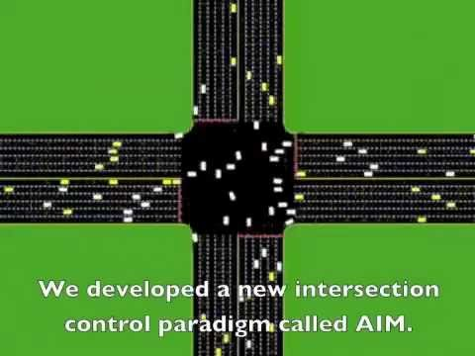
AI Will Fundamentally Change Society
Tesla Self Driving Demo: https://www.facebook.com/tesla/videos/10154712005882801/?pnref=story

Slide 29
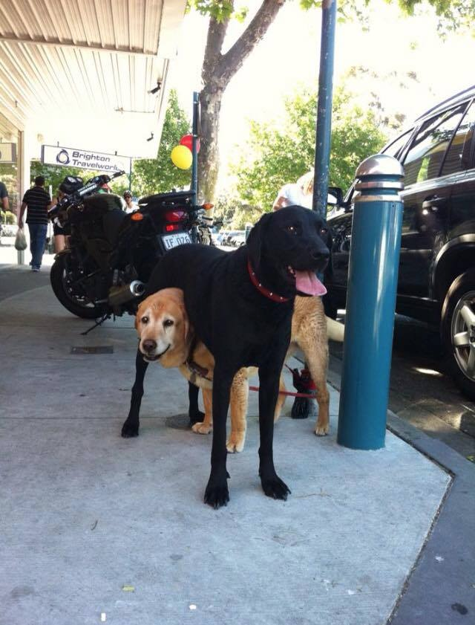

The Long View
Leaving a bunch of hydrogen lying around in space seems to result in rather complex outcomes.
Link

Slide 30
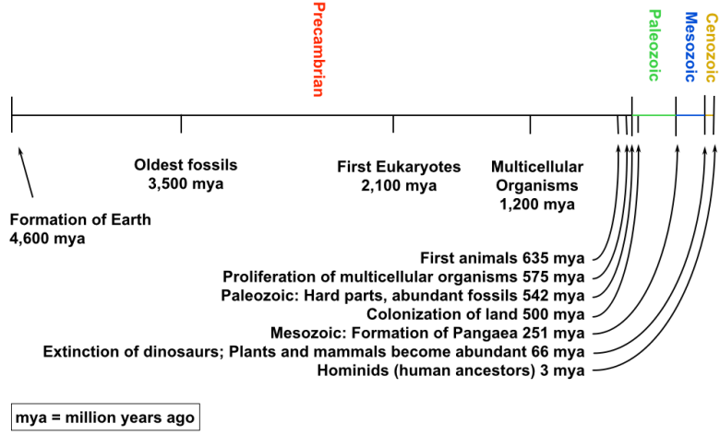
History of Biological Intelligence
Link

Slide 31
Human Equivalent AI?
The ultimate achievement of AI would be human-equivalent intelligence.
Assuming the world is purely physical (physical reductionism), cognition is achievable in ~50 watts and 3 pounds of hardware.
Assuming that evolution is correct, possible to arrive at this design through a very crude and slow training process.
Conceivable that in decades, centuries, or millennia that our human-directed-evolution-of-machines will arrive at human equivalent intelligence.
“...we might very well see relatively slow and incremental progress that doesn’t really raise any alarm bells until we are just one step away from something that is radically superintelligent.” - Nick Bostrom
Then what?

Slide 32
Future History of AI (Naive)
Intelligence
Nobel Prize Human
Idiot Human
This part won’t last long.
Chimp
Mouse
We are somewhere here.
Year

Slide 33
Human Equivalent Artificial Intelligence
Human equivalent intelligence could eliminate the need for any further invention by mankind.
Want a new employee? Spin up a process.
Even more interesting: “Let an ultraintelligent machine be defined as a machine that can far surpass all the intellectual activities of any man however clever. Since the design of machines is one of these intellectual activities, an ultraintelligent machine could design even better machines; there would then unquestionably be an 'intelligence explosion,' and the intelligence of man would be left far behind.” - IJ Good (1965)

Slide 34
Future History of AI [My Best Guess]
Intelligence
End of “the human era”.
AIs start helping design AI, deep learning hardware, factories, power plants, governments and economic systems, network infrastructure, etc.
Nobel Prize Human
Idiot Human
Chimp
Mouse
The “bloom” may not occur for thousands of years, and it may take a while, but this shape seems pretty likely to me
Year

Slide 35
Questions About Anything?

Slide 36
After 188

Slide 37
Major Things That Were Different This Time (From Spring 16)
Week 1 through 8 notes (special thanks to Nikhil and Rosie).
Sorry we didn’t produce them all semester, but I hope that you found them useful!
Today’s lecture slide summary of entire course.
Question-goat questions.
Substantial reorganization of many lectures (esp. Deep Learning).
In-lecture math review for ML topics (too slow??)
Dedicated project-expert staff from previous semester (Anwar and Won).
Two midterms instead of 1.
Token based client side autograder (Thanks Allen!)
New Project 6.
Sorry it’s rough, but the old project was :(
Let me know what you thought of this flavor of “from scratch” project vs. the existing “fill-in-the-function” projects.

Slide 38
Things For Next Time
Possibilities:
Cut CSPs to one day.
Go back in time and delete the “count the number of times this algorithm backtracks” style problem.
Put D-Separation back in?
More structure on learning the theory?
One or two fewer projects?
A few written homeworks?
Make real-world usefulness of techniques more apparent throughout course.
Let me know what else you’ve missed.

Slide 39
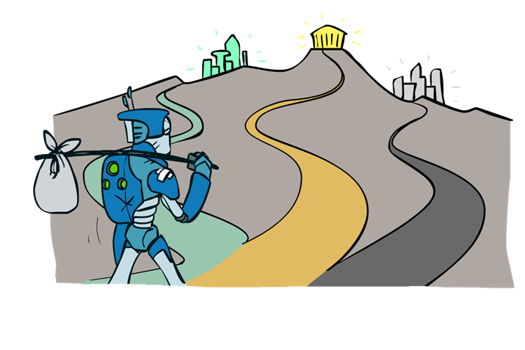
Where to go next?
Congratulations, you’ve seen the basics of modern AI
… and done some amazing work putting it to use!
What next?
Machine learning: cs189, stat154
Intro to Data Science: CS8 or new course (SP17?)
Probability: ee126, stat134
Optimization: ee127
Cognitive modeling: cog sci 131
Machine learning theory: cs281a/b
Vision: cs280
Robotics: cs287
Algorithmic Human Robot Interaction: CS294-115
NLP: cs288
Fall 2017 with Adam: AUDIO 225D

Slide 40
Getting Involved in AI/ML
For research opportunities:
See: https://eecs.berkeley.edu/research
Talk to your TAs about dropping in on research group meetings.
Volunteer to help out in lab (by talking to TAs, postdocs or professors)
One interesting opportunity:
Professor Laurent El Ghaoui and one of my old grad school buddies Andrew Godbehere are working on a set of AI tools for understanding congressional transcripts.
Email me if you want to help out! Requires no fancy knowledge.

Slide 41
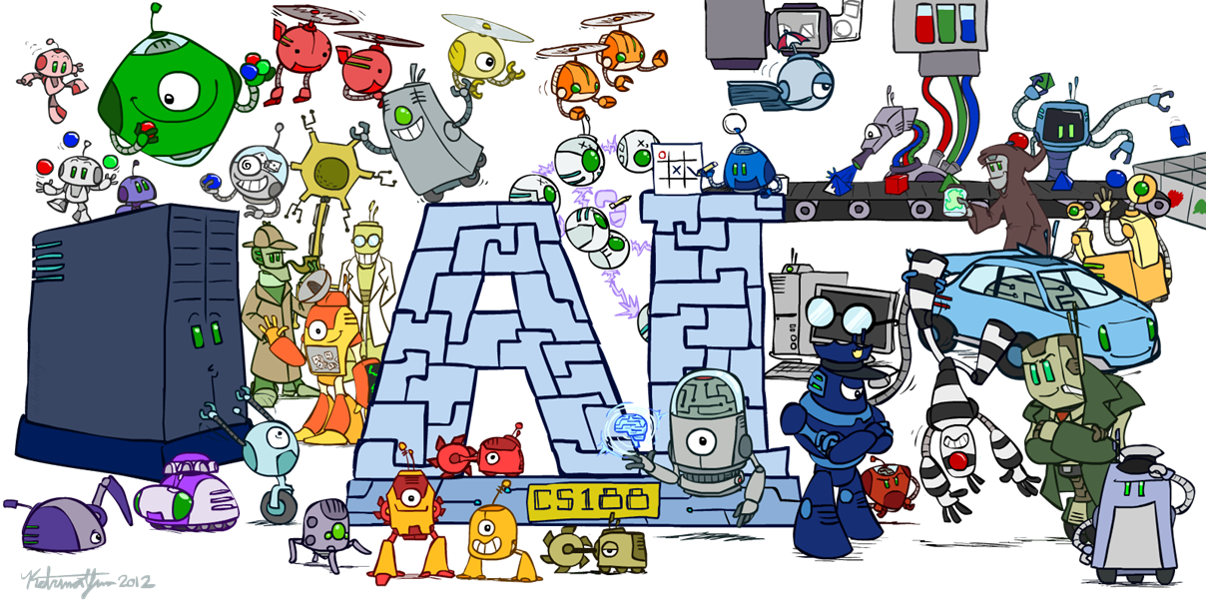

Slide 42
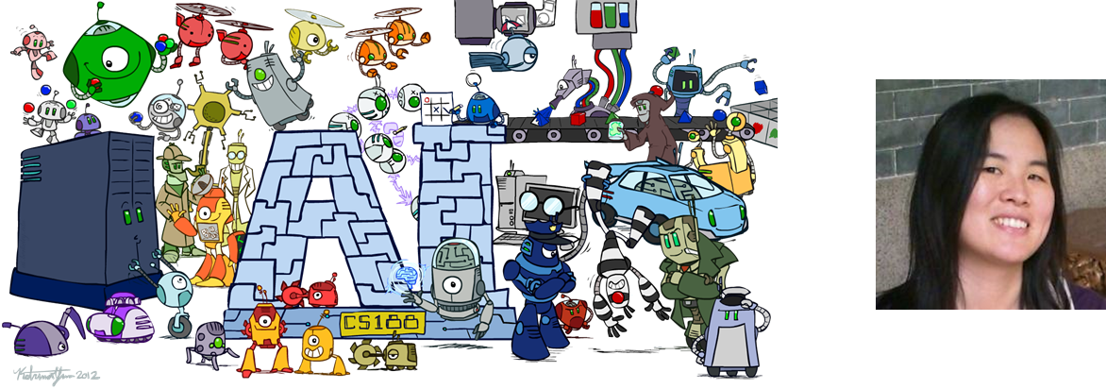
Special thanks to the Ketrina Yim!
Ketrina Yim
CS 188 Artist

Slide 43
Special thanks to the Staff!
Becca Roelofs Steven Bi Allen Guo Rosie Jia
Michael Laskey Sherdil Niyaz Aldo Pacchiano Nick Rose
Nikhil Sharma Caryn Tran Anwar Baroudi Won Park
Ted Xiao
(Link)
And to Adam Janin as well!
First time teaching in a long while, and quite a hero for operating in this strange 500+ student environment while also having another full time job!

Slide 44
Things to Ponder Filling Out Course Survey
New Aspects of Course: What did you like / not like?
In-lecture question-goat, reworking of lectures to have a strong story (but sometimes slower than previous semesters)
Two midterms instead of 1.
New project 6: Build and train perceptron and neuron from scratch.
Week 1 - 8 lecture notes.
Token-based client side autograder.
course-evaluations.berkeley.edu
Coming up? What do you think your successors will want?
Written homeworks or other ways to reinforce understanding of theory?
Increase obviousness of connections to real world?
Cut some CSPs, add back D-separation officially?
Changes you’d like to projects?

